Slide 1

CHAPTER 1 Computer System overview
Instructor: Wuman LUO
luowuman@ipm.edu.mo
Office: A213
14:30-17:30 Tuesday & Wednesday

Slide 2

What This Course is About
User
Application Programs (web browsers, development kits, etc)
Operating System
Computer Hardware (CPU, memory, I/O devices, etc)

Slide 3
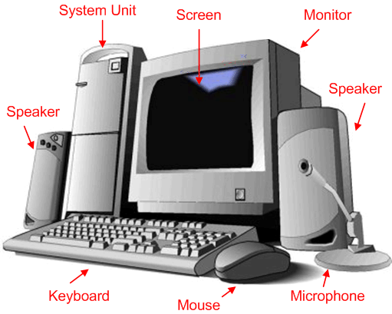
Components of a Simple PC
Notes:
An operating system (OS) exploits the hardware resources of one or more processors to provide a set of services to system users. The OS also manages secondary memory and I/O (input/output) devices on behalf of its users. Accordingly, it is important to have some understanding of the underlying computer system hardware before we begin our examination of operating systems.

Slide 4
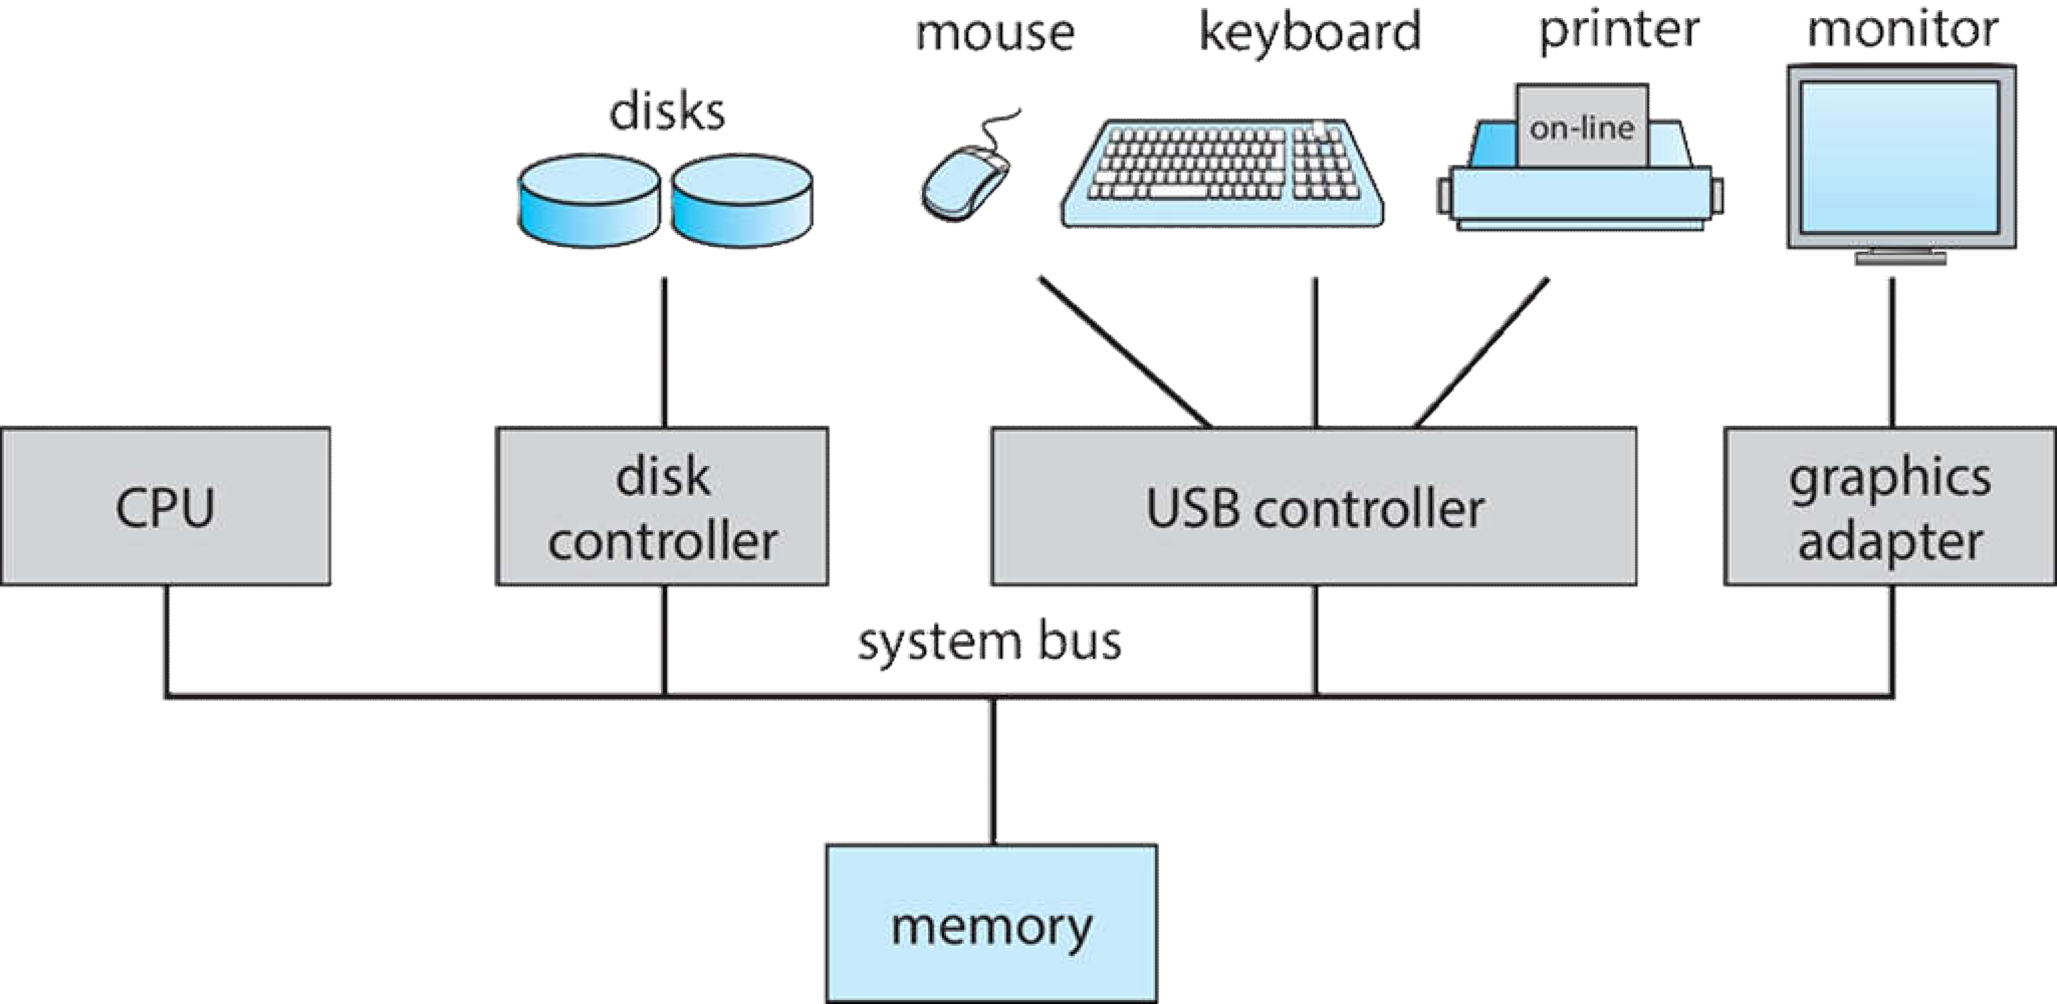
Major Computer Components
Typical components:
Processor(s)
Main Memory
I/O Modules
System Interconnection (bus)
I/O Modules
Processor(s)
System Interconnection (bus)
Main Memory
Notes:
At a top level, a computer consists of processor, memory, and I/O components, with one or more modules of each type. These components are interconnected in some fashion to achieve the main function of the computer, which is to execute programs. Thus, there are four main structural elements:

Slide 5
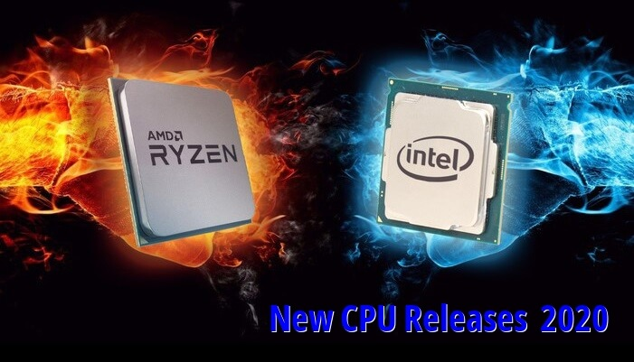

Processor
Controls the operation of the computer
Performs the data processing functions
Referred to as the Central Processing Unit (CPU)
The heart and soul of a computer!
Notes:
Processor : Controls the operation of the computer and performs its data processing functions. When there is only one processor, it is often referred to as the central processing unit (CPU).

Slide 6
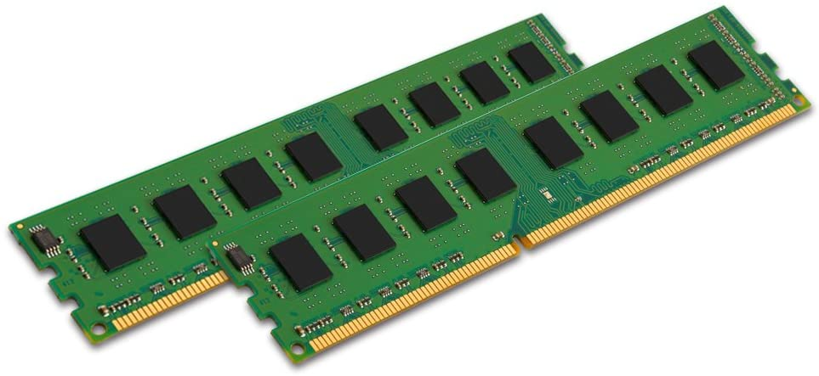
Main Memory
Holds data and instructions temporarily which the CPU will process and execute
Volatile
Contents of the memory is lost when the computer is shut down
Referred to as real memory or primary memory
Notes:
Main memory : Stores data and programs. This memory is typically volatile; that is, when the computer is shut down, the contents of the memory are lost. In contrast, the contents of disk memory are retained even when the computer system is shut down. Main memory is also referred to as real memory or primary memory.

Slide 7
I/O Modules
Moves data between the computer and external environments such as:
Storage (e.g. hard drive)
Communications Equipment
Terminals
Notes:
I/O modules : Move data between the computer and its external environment. The external environment consists of a variety of devices, including secondary memory devices (e.g., disks), communications equipment, and terminals.

Slide 8
System Bus
Provides for communication among processors, main memory, and I/O modules
Notes:
System bus : Provides for communication among processors, main memory, and I/O modules.

Slide 9
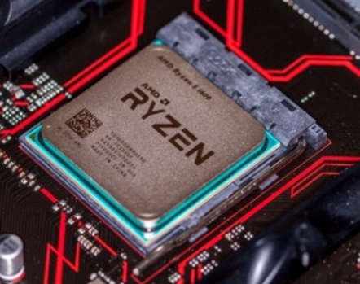
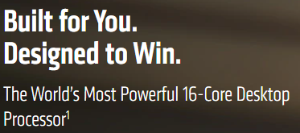

Microprocessor
Invention that brought about desktop and handheld computing
Processor on a single chip
Fastest general purpose processor
Multiprocessors
Each chip (socket) contains multiple processors (cores)
AMD Ryzen 9 3950X:
16 cores, 32 threads, 3.5-4.7GHz
L1 64KB/core, L2 512KB/core, L3 64MB Thermal design power (TDP) 105W
Notes:
The hardware revolution that brought about desktop and handheld computing was the invention of the microprocessor, which contained a processor on a single chip. Though originally much slower than multichip processors, microprocessors have continually evolved to the point that they are now much faster for most computations due to the physics involved in moving information around in sub-nanosecond timeframes.
Not only have microprocessors become the fastest general purpose processors available, they are now multiprocessors; each chip (called a socket) contains multiple processors (called cores), each with multiple levels of large memory caches, and multiple logical processors sharing the execution units of each core. As of 2010, it is not unusual for even a laptop to have 2 or 4 cores, each with 2 hardware threads, for a total of 4 or 8 logical processors.

Slide 10
Graphical Processing Units (GPU’s)
Provide efficient computation on arrays of data using Single-Instruction Multiple Data (SIMD) techniques
Good for general numerical processing, such as
Physics simulations for games
Computations on large spreadsheets
CPUs are gaining the capability of operating on arrays of data
G
P
U
Processors and GPUs are NOT the end of computational story for modern PC
Notes:
Although processors provide very good performance for most forms of computing, there is increasing demand for numerical computation. Graphical Processing Units (GPUs) provide efficient computation on arrays of data using Single-Instruction Multiple Data (SIMD) techniques pioneered in supercomputers. GPUs are no longer used just for rendering advanced graphics, but they are also used for general numerical processing, such as physics simulations for games or computations on large spreadsheets. Simultaneously, the CPUs themselves are gaining the capability of operating on arrays of data—with increasingly powerful vector units integrated into the processor architecture of the x86 and AMD64 families. Processors and GPUs are not the end of the computational story for the modern PC.
Single instruction, multiple data (SIMD) is a class of parallel computers in Flynn's taxonomy. It describes computers with multiple processing elements that perform the same operation on multiple data points simultaneously. Such machines exploit data level parallelism, but not concurrency: there are simultaneous (parallel) computations, but only a single process (instruction) at a given moment. SIMD is particularly applicable to common tasks such as adjusting the contrast in a digital image or adjusting the volume of digital audio. Most modern CPU designs include SIMD instructions to improve the performance of multimedia use. SIMD is not to be confused with SIMT, which utilizes threads.

Slide 11
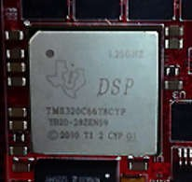
Digital Signal Processors (DSPs)
Deal with streaming signals such as audio or video
Used to be embedded in devices like modems
Encoding/decoding speech and video (codecs)
Support for encryption and security
1.25GHz, 8-core, TMS320C6678 DSP
D
S
P
A DSP is a specialized microprocessor chip, with its architecture optimized for the operational needs of digital signal processing.
Notes:
Digital Signal Processors (DSPs) are also present, for dealing with streaming signals—such as audio or video. DSPs used to be embedded in I/O devices, like modems, but they are now becoming first-class computational devices, especially in handhelds. Other specialized computational devices (fixed function units) co-exist with the CPU to support other standard computations, such as encoding/decoding speech and video (codecs), or providing support for encryption and security.

Slide 12

System on a Chip (SoC)
To satisfy the requirements of handheld devices, the microprocessor is giving way to the SoC
Components such as DSPs, GPUs, codecs and main memory, in addition to the CPUs and caches, are on the same chip

Slide 13
Computer Components: Top Level View
Main Memory
I/O Module
CPU
00000
PC
I/O AR
buffers
Instruction
00001
IR
I/O BR
Instruction
00002
MAR
00003
Execution unit
Data
00004
MBR
Data
00005
PC = Program counter
IR = Instruction register
MAR = Memory address register
MBR = Memory buffer register
I/O AR = Input/output address register
I/O BR = Input/output buffer register
.
System Bus
Notes:
This figure depicts the top-level components. One of the processor’s functions is to exchange data with memory. For this purpose, it typically makes use of two internal (to the processor) registers: a memory address register (MAR), which specifies the address in memory for the next read or write; and a memory buffer register (MBR), which contains the data to be written into memory or which receives the data read from memory. Similarly, an I/O address register (I/O AR) specifies a particular I/O device. An I/O buffer register (I/O BR) is used for the exchange of data between an I/O module and the processor.
A memory module consists of a set of locations, defined by sequentially numbered addresses. Each location contains a bit pattern that can be interpreted as either an instruction or data. An I/O module transfers data from external devices to processor and memory, and vice versa. It contains internal buffers for temporarily holding data until they can be sent on.
Execution unit: ALU(ARITHMETIC LOGICAL UNIT) the arithmetic and logic unit carries out the arithmetic and Boolean operation needed during program execution

Slide 14
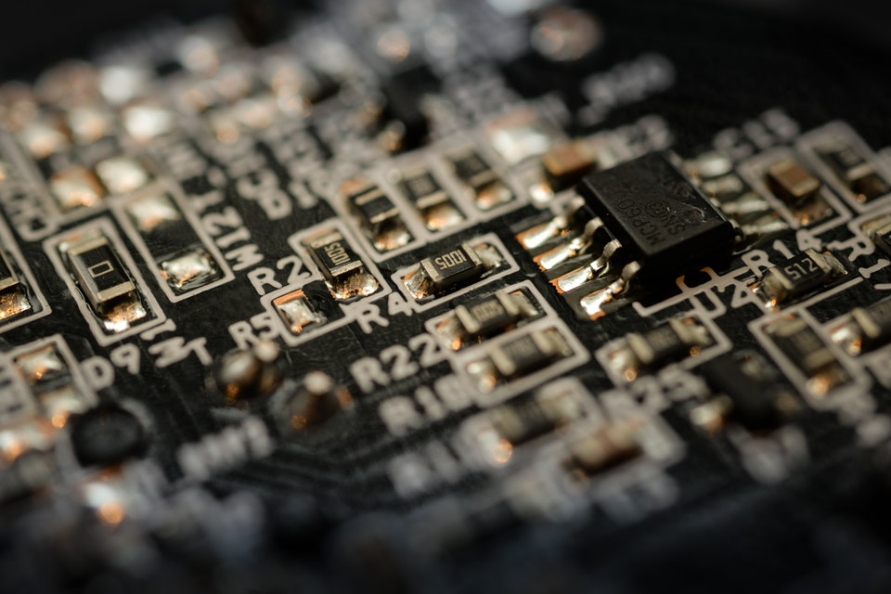
What is a Register?
A type of memory inside the CPU that is faster and smaller than main memory
More expensive
Each usually holds only single value, e.g., instruction, data or address
Notes:
registers can be organized into two main categories i.e. the User-Visible Registers and the Control and Status Registers. Although we can’t separate the registers in the processors clearly among these two categories.

Slide 15
Control and Status Registers
Program Counter (PC)
Contains address of next instruction to be fetched
Instruction Register (IR)
Contains the most recently fetched instruction for next execution
MAR
specifies the address in memory for the next read or write
MBR
contains the data to be written into memory or which receives the data read from memory
I/O AR, I/O BR
Usually, most of these registers are NOT directly visible to system programmers
Notes:
https://binaryterms.com/register-organization.html#ControlandStatusRegisters

Slide 16
MAR & MBR in Action
RAM
CPU
00000
MAR
00001
123
00001
MBR
123
26
00002
PC
00001
00003
IR
123
00004
00005
.

Slide 17
User-Visible Registers
Are visible to the assembly or machine language programmers
They use them effectively to minimize the memory references in the instructions
Type1: general purpose register
Store addresses, data, or intermediate results
Type 2: data register
For data only
Type 3: address register
Contain main memory address of data and instructions
E.g., segment pointer register, index register, stack pointer register
Notes:
1. General Purpose Register
The general-purpose registers detain both the addresses or the data. Although we have separate data registers and address registers. The general purpose register also accepts the intermediate results in the course of program execution.
Well, the programmers can restrict some of the general-purpose registers to specific functions. Like, some registers are specifically used for stack operations or for floating-point operations. The general-purpose register can also be employed for the addressing functions.
2. Data Register
The term itself describes that these registers are employed to hold the data. But the programmers can’t use these registers for calculating operand address.
3. Address Register
Now, the address registers contain the address of an operand or it can also act as a general-purpose register. An address register may be dedicated to a certain addressing mode. Let us understand this with the examples.
(a) Segment Pointer Register A memory divided in segments, requires a segment register to hold the base address of the segment. There can be multiple segment registers. As one segment register can be employed to hold the base address of the segment occupied by the operating system. The other segment register can hold the base address of the segment allotted to the processor.
(b) Index Register The index register is employed for indexed addressing and it is initial value is 0. Generally, it used for traversing the memory locations. After each reference, the index register is incremented or decremented by 1, depending upon the nature of the operation. Sometime the index register may be auto indexed.
(c) Stack Pointer Register The stack register has the address that points the stack top.

Slide 18
Program Status Word (PSW)
Contains the status information
The fields included in PSW:
Results of operations: sign, zero, carry, equal
Other control bits:
Overflow: indicate arithmetic overflow
Interrupt: enable/disable
Supervisor: supervisor mode/user mode
Notes:
The fields included in Program Status Word (PSW):
Sign: This field has the resultant sign bit of the last arithmetic operation performed.
Zero: This field is set when the result of the operation is zero.
Carry: This field is set when an arithmetic operation results in a carry into or borrow out.
Equal: If a logical operation results in, equality the Equal bit is set.
Overflow: This bit indicates the arithmetic overflow.
Interrupt: This bit is set to enable or disable the interrupts.
Supervisor: This bit indicates whether the processor is executing in the supervisor mode or the user mode.

Slide 19
Instruction Cycle
A program consists of a set of instructions stored in memory
processor reads instructions from memory one at a time
processor executes each instruction
Two steps
Fetch Stage
Execute Stage
Fetch Next
Instruction
Execute
Instruction
START
HALT
Basic Instruction Cycle
Notes:
A program to be executed by a processor consists of a set of instructions stored in memory. In its simplest form, instruction processing consists of two steps: The processor reads ( fetches ) instructions from memory one at a time and executes each instruction. Program execution consists of repeating the process of instruction fetch and instruction execution. Instruction execution may involve several operations and depends on the nature of the instruction.

Slide 20
Instruction Fetch
Program counter (PC) holds address of the instruction to be fetched next
The processor fetches the instruction from memory to the Instruction Register (IR)
Program counter is incremented after each fetch
Processor-Memory
Transfer data between processor and memory
Processor-I/O
Transfer data between processor and I/O module
大数据技术的发展现状
——The Big Picture
Category of Instructions
Data Processing
Perform arithmetic or logic operation on data
Control
Change the sequence of execution

Slide 21
Instruction Execution
RAM
CPU
00000
PC
00001
MOV AX, [00009]
00001
The CPU executes the instruction pointed by PC, one after another.
IR
MOV AX, [00009]
INC AX
00002
AX
0
MOV [00009], AX
00003
GOTO 00001
00004
00005
How can it handle I/O and multiprogramming?
.
0
00009

Slide 22
Interrupts
Interrupt the normal sequencing of the processor
Provided to improve processor utilization
most I/O devices are slower than the processor
processor must pause to wait for device
wasteful use of the processor
Notes:
Virtually all computers provide a mechanism by which other modules (I/O, memory) may interrupt the normal sequencing of the processor.
Interrupts are provided primarily as a way to improve processor utilization. For example, most I/O devices are much slower than the processor. Suppose that the processor is transferring data to a printer. After each write operation, the processor must pause and remain idle until the printer catches up. The length of this pause may be on the order of many thousands or even millions of instruction cycles. Clearly, this is a very wasteful use of the processor.

Slide 23
Classes of Interrupts
Program | Generated by some condition that occurs as a result of an instruction execution, such as arithmetic overflow, division by zero, attempt to execute an illegal machine instruction, and reference outside a user's allowed memory space.
Timer | Generated by a timer within the processor. This allows the operating system to perform certain functions on a regular basis.
I/O | Generated by an I/O controller, to signal normal completion of an operation or to signal a variety of error conditions.
Hardware Failure | Generated by a failure, such as power failure or memory parity error.
Notes:
Motivations: a technique to improve the efficiency of the processor (or CPU) when slower hardware (mainly I/O devices, hard drive) is required during the execution of the program.
Objectives: the processor can do something else while I/O is in progress.

Slide 24
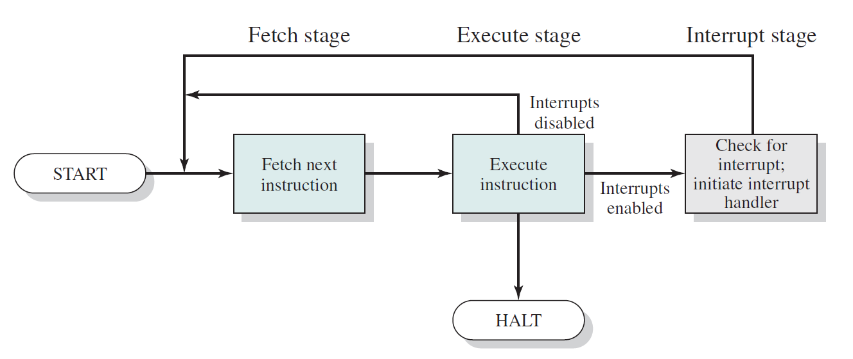
Instruction Cycle with Interrupt
Notes:
To accommodate interrupts, an interrupt stage is added to the instruction cycle, as shown in Figure 1.7 (compare Figure 1.2 ). In the interrupt stage, the processor checks to see if any interrupts have occurred, indicated by the presence of an interrupt signal. If no interrupts are pending, the processor proceeds to the fetch stage and fetches the next instruction of the current program. If an interrupt is pending, the processor suspends execution of the current program and executes an interrupt handler routine. The interrupt-handler routine is generally part of the OS. Typically, this routine determines the nature of the interrupt and performs whatever actions are needed. In the example we have been using, the handler determines which I/O module generated the interrupt and may branch to a program that will write more data out to that I/O module. When the interrupt-handler routine is completed, the processor can resume execution of the user program at the point of interruption.

Slide 25
Interrupt Stage
Processor checks for interrupts
If no interrupts, fetch the next instruction for the current program
If an interrupt is pending, suspend execution of the current program, and execute the interrupt handler
Interrupt Stage
Notes:
Certain overhead is required to monitor the status of the interrupts, e.g. which I/O module invokes the interrupt, etc..
It is still worth using interrupts as much more processor resource can be saved while large amount of I/O is involved.

Slide 26

Interrupt Handler
A program that determines nature of the interrupt and performs whatever actions are needed
When the CPU is interrupted, control is transferred to this program
When finished, control is transferred back to the program interrupted
Generally part of the operating system

Slide 27
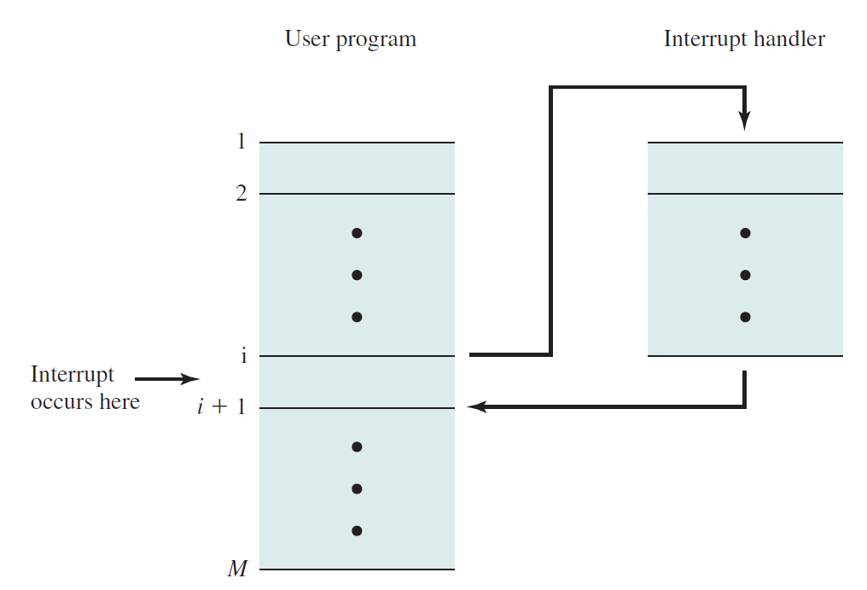
Transfer of Control via Interrupts
User program
Interrupt handler
Interrupt occurs here
The processor and the OS are responsible for suspending the user program and then resuming it at the same point
User program does not need special code to accommodate interrupts
Notes:
For the user program, an interrupt suspends the normal sequence of execution. When the interrupt processing is completed, execution resumes. Thus, the user program does not have to contain any special code to accommodate interrupts; the processor and the OS are responsible for suspending the user program and then resuming it at the same point.

Slide 28
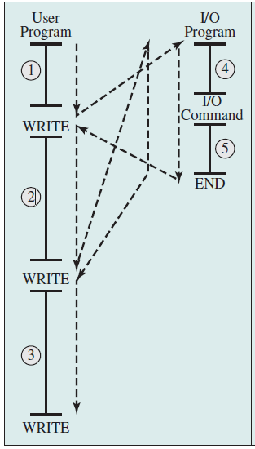
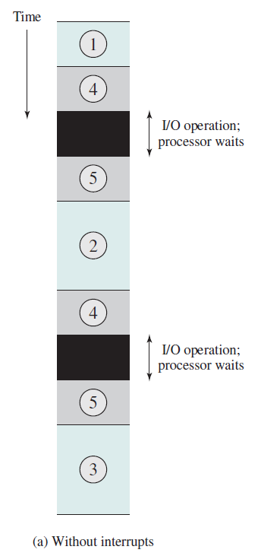
Program Flow of Control and Timing Without Interrupts
Notes:
To give a specific example, consider a PC that operates at 1 GHz, which would allow roughly 10⁹ instructions per second. A typical hard disk has a rotational speed of 7200 revolutions per minute for a half-track rotation time of 4 ms, which is 4 million times slower than the processor.
This figure illustrates this state of affairs. The user program performs a series of WRITE calls interleaved with processing. The solid vertical lines represent segments of code in a program. Code segments 1, 2, and 3 refer to sequences of instructions that do not involve I/O. The WRITE calls are to an I/O routine that is a system utility and that will perform the actual I/O operation. The I/O program consists of three sections:
• A sequence of instructions, labeled 4 in the figure, to prepare for the actual I/O operation. This may include copying the data to be output into a special buffer and preparing the parameters for a device command.
• The actual I/O command. Without the use of interrupts, once this command is issued, the program must wait for the I/O device to perform the requested function (or periodically check the status, or poll, the I/O device). The program might wait by simply repeatedly performing a test operation to determine if the I/O operation is done.
• A sequence of instructions, labeled 5 in the figure, to complete the operation. This may include setting a flag indicating the success or failure of the operation.
The dashed line represents the path of execution followed by the processor; that is, this line shows the sequence in which instructions are executed. Thus, after the first WRITE instruction is encountered, the user program is interrupted and execution continues with the I/O program. After the I/O program execution is complete, execution resumes in the user program immediately following the WRITE Instruction.
Because the I/O operation may take a relatively long time to complete, the I/O program is hung up waiting for the operation to complete; hence, the user program is stopped at the point of the WRITE call for some considerable period of time.

Slide 29
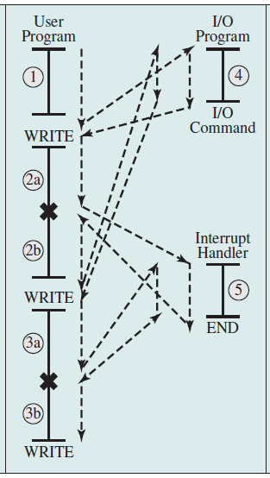
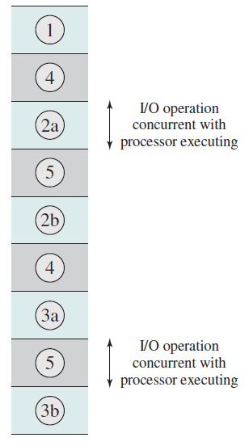
Program Flow of Control and Timing With Interrupts

Slide 30

The Memory Hierarchy (1/3)
Three key characteristics of memory
Capacity
Access time
Cost
Memory must be able to keep up with the processor
Cost of memory must be reasonable in relationship to the other components
How Much?
How Fast?
How Expensive?
Notes:
The design constraints on a computer’s memory can be summed up by three questions: How much? How fast? How expensive?
The question of how much is somewhat open ended. If the capacity is there, applications will likely be developed to use it. The question of how fast is, in a sense, easier to answer. To achieve greatest performance, the memory must be able to keep up with the processor. That is, as the processor is executing instructions, we would not want it to have to pause waiting for instructions or operands. The final question must also be considered. For a practical system, the cost of memory must be reasonable in relationship to other components.

Slide 31
The Memory Hierarchy (2/3)
Faster access time = greater cost per bit
Greater capacity = smaller cost per bit
Greater capacity = slower access speed
Notes:
As might be expected, there is a trade-off among the three key characteristics of memory: namely, capacity, access time, and cost. A variety of technologies are used to implement memory systems, and across this spectrum of technologies, the following relationships hold:
• Faster access time, greater cost per bit
• Greater capacity, smaller cost per bit
• Greater capacity, slower access speed

Slide 32
The Memory Hierarchy (3/3)
Going down the hierarchy:
decreasing cost per bit
increasing capacity
increasing access time
decreasing frequency of access to the memory by the processor
Registers
Cache
Main Memory
Disk Cache
Magnetic Disk
Magnetic Tape
Optical Disk
Notes:
More details will be given when we discuss memory management and virtual memory.

Slide 33
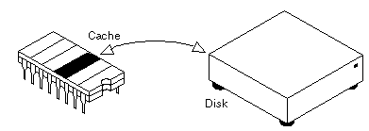
Disk Cache
A portion of main memory used as a buffer to temporarily hold data for the disk
Disk writes are clustered
Some data written out may be referenced again.
The data are retrieved rapidly from the software cache instead of slowly from disk
Notes:
Additional levels can be effectively added to the hierarchy in software. For
example, a portion of main memory can be used as a buffer to temporarily hold data
that are to be read out to disk. Such a technique, sometimes referred to as a disk
cache (to be examined in detail in Chapter 11), improves performance in two ways:
1. Disk writes are clustered. Instead of many small transfers of data, we have a few large transfers of data. This improves disk performance and minimizes processor involvement.
2. Some data destined for write-out may be referenced by a program before the next dump to disk. In that case, the data are retrieved rapidly from the software cache rather than slowly from the disk.

Slide 34
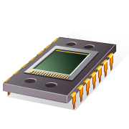
Cache Memory - Motivation
Processor speed is faster than memory speed
Instruction execution is limited by the memory speed
Use technology of processor register? Too expensive!
Principle of Locality
Is the tendency of a processor to access the same set of memory locations repetitively over a short period of time.
Cache Principles
Intended to provide memory access time approaching that of the fastest memories available
At the same time support a large less expensive memory size
Notes:
Although cache memory is invisible to the OS, it interacts with other memory management hardware.
On all instruction cycles, the processor accesses memory at least once, to fetch the
instruction, and often one or more additional times, to fetch operands and/or store
results.
Over the years, processor
speed has consistently increased more rapidly than memory access speed.
Ideally, main memory should be
built with the same technology as that of the processor registers, giving memory
cycle times comparable to processor cycle times. This has always been too expensive
a strategy

Slide 35
Cache Memory – How it Works
Invisible to operating system
Faster and smaller compared with the main memory
How it works
Contains a small portion of main memory
Processor first checks cache
If no found in cache, the block of memory containing the needed information is fetched into the cache
Small caches have a significant impact on performance

Slide 36
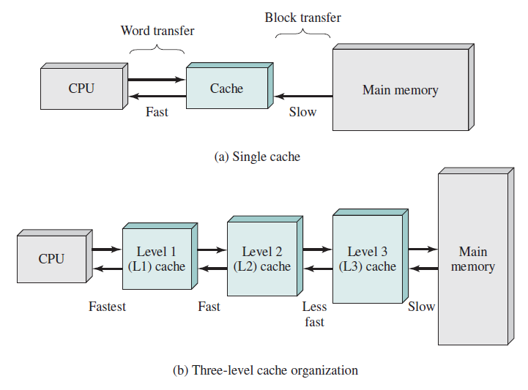
Cache and Main Memory
Notes:
Figure 1.16b depicts the use of multiple levels of cache. The L2 cache is slower
and typically larger than the L1 cache, and the L3 cache is slower and typically larger
than the L2 cache.

Slide 37
I/O Communication Techniques
When the processor encounters an instruction relating to I/O, it executes that instruction by issuing a command to the appropriate I/O module
Three techniques are possible for I/O operations:
Programmed I/O
Interrupt-Driven I/O
Direct Memory Access (DMA)
Notes:
Three techniques are possible for I/O operations: programmed I/O, interrupt-driven
I/O, and direct memory access (DMA).

Slide 38
Programmed I/O
No interrupts occur
Processor is kept busy checking status
procedure readString (var s);
repeat
send I/O command “go read a word”
repeat
Read I/O status
until I/O done
Read word from I/O module
Write word into memory
until finished reading
……
I/O are much slower than the CPU.
It is very inefficient for the CPU to wait for I/O completion in a tight loop. (busy waiting).
More on this in later chapters.
Notes:
Tight loop:
1. (programming) A loop which contains few instructions and iterates many times.
2. (programming) Such a loop which heavily uses I/O or processing resources, failing to adequately share them with other programs running in the operating system.

Slide 39
Interrupt-Driven I/O
No busy waiting.
Processor can proceed to do other things when I/O is in progress
When I/O is done, the CPU is interrupted
procedure readString (var s);
repeat
Send I/O command “go read a word”
…
now, the CPU will do something else
don’t bother checking I/O status
…
…
until finished reading
……
Still consumes a lot of processor time because every word read or written passes through the processor
When the I/O module finished reading the word, it interrupts the CPU. The CPU will execute an interrupt handler to move the word to memory.
/* interrupt handler */
Read word from I/O module
Write word into memory
return
Afterwards, control is returned to the program which continues to read the next word.

Slide 40
Interrupt-Driven I/O
No busy waiting.
Processor can proceed to do other things when I/O is in progress
When I/O is done, the CPU is interrupted
procedure readString (var s);
repeat
Send I/O command “go read a word”
…
now, the CPU will do something else
don’t bother checking I/O status
…
…
until finished reading
……
Interrupt-driven I/O is still inefficient in data transfer of large amount because the CPU has to transfer the data word by word between I/O module and memory.

Slide 41
Direct Memory Access (1/3)
Processor grants I/O module authority to read from or write to memory
DMA module controls exchange of data between main memory and the I/O device
Processor interrupted only after entire block has been transferred
The processor is only involved at the beginning and end of the transfer

Slide 42
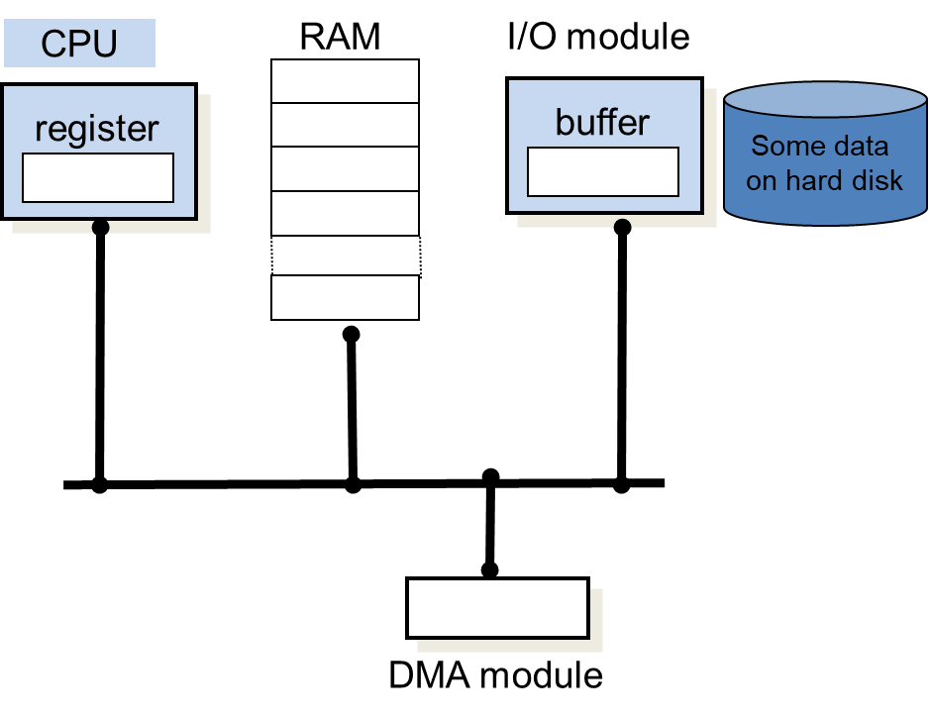
Direct Memory Access (2/3)

Slide 43
Direct Memory Access (3/3)
procedure readString (var s);
Request the DMA module
to read some data
…
now, the CPU will do something else
don’t bother checking I/O status
…
The DMA module starts reading each word of the data and save them in the memory.
After the DMA has transferred all the data requested to the memory, it notifies that it has finished the I/O by sending the CPU an interrupt
DMA I/O is more efficient in large data transfer because the interaction with the I/O module and data transfer between I/O module and memory are performed by the DMA module.

Slide 44

Summary
Basic elements
Instruction execution
Interrupts
The memory hierarchy
I/O Communication Techniques

